Slide 1
QM Lab
Team 3 Infrastructure and Incremental Deliverable 1

Slide 2
Outline
Who we are
Requirements
Design
Implementation Demo
Summary
Questions

Slide 3
Who we are
Project management
Royce M.
Build and Integration
Shane W.
Risk Officer
James M.
Testing
Mahmoud M., Bengin L., Angela S., Jordan W.
Triage
James M., Bengin L.
Design
Corey H., Darvin Z., Mitchell L.
Implementation
Michael R., Michael K., Matt H, Connor N-G, Shane W.

Slide 4
Requirements
Scope
Must haves, should have, nice to haves
Collaborative, agents, variables and parameters
Actors
Users, server, database, interface

Slide 5
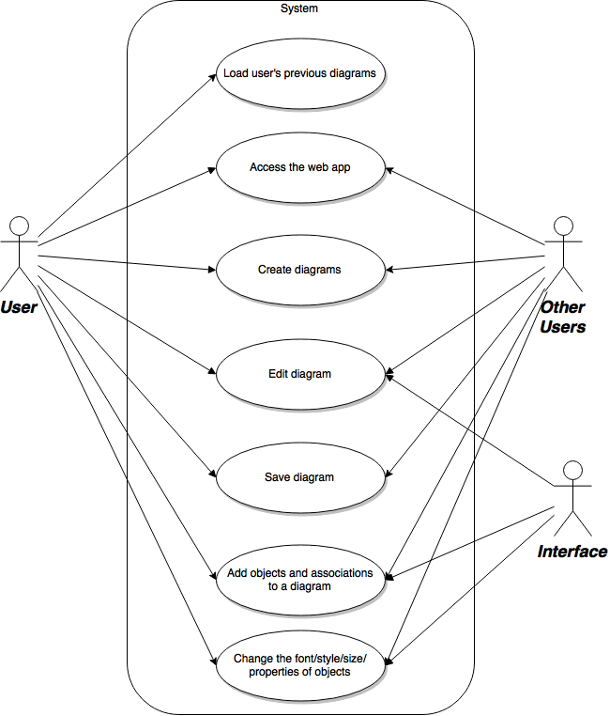
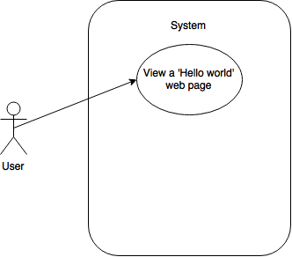
Use Case Diagrams
Figure: Use case for ID1
Figure: Use case for users

Slide 6
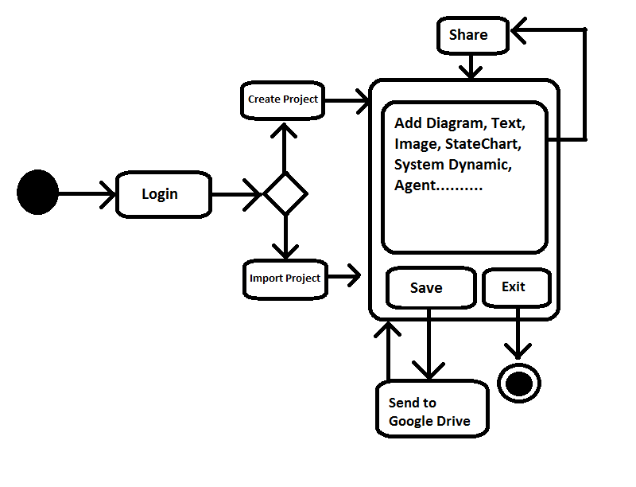
Activity Diagram
Figure: Overall activity diagram

Slide 7
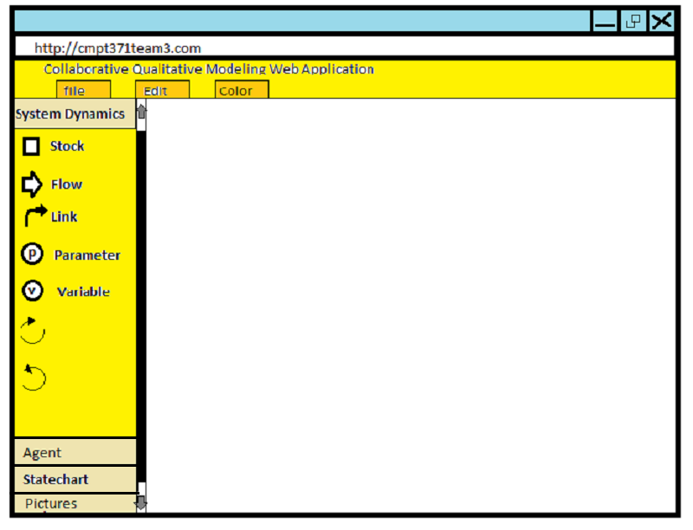
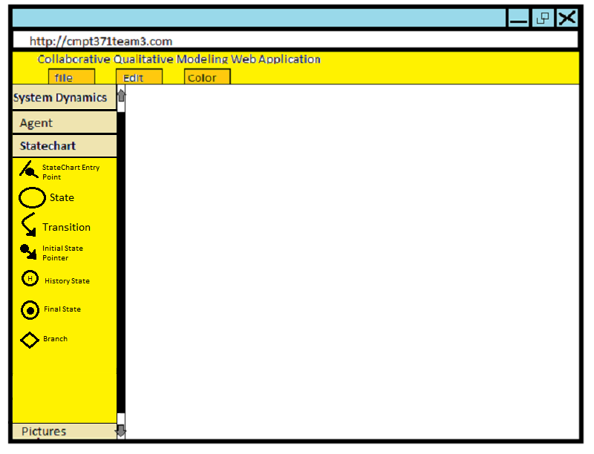
Storyboard
Figure: Storyboard of app with system dynamics
Figure: Storyboard of app with statechart

Slide 8
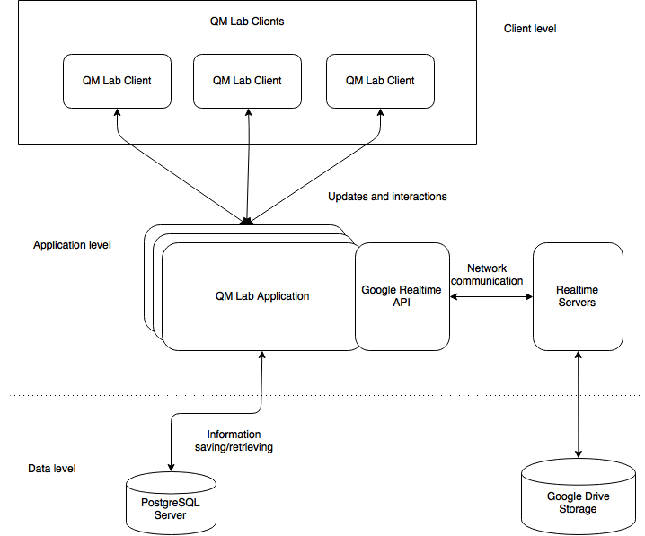
Architecture Diagram
Figure: 3-tier architecture system diagram

Slide 9
Models
Models
Flyweight, singleton, observer
Classes
Main page, project, edit

Slide 10
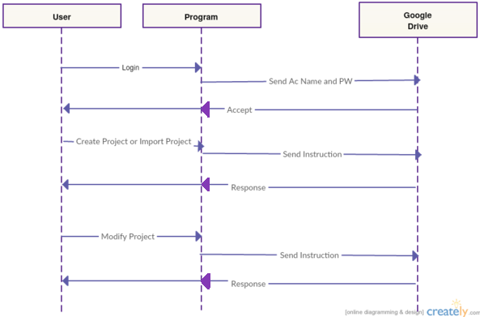
Sequence Diagram
Figure: Sequence diagram of overall system

Slide 11
Implementation Demo

Slide 12
Summary
Requirements
Scope, actors, use case and activity diagrams, storyboards
Design
Architecture diagram, model, sequence diagram
Implementation Demo

Slide 13
Thanks for listening!
Questions?

